Slide 1
BHDreamAmc
ClairvoYANT And Techgig hackathon
By:- Rohit Joshi

Slide 2
Tech-Stack
Frontend- ReactJS
Backend- Django
DataBase- SQLite

Slide 3
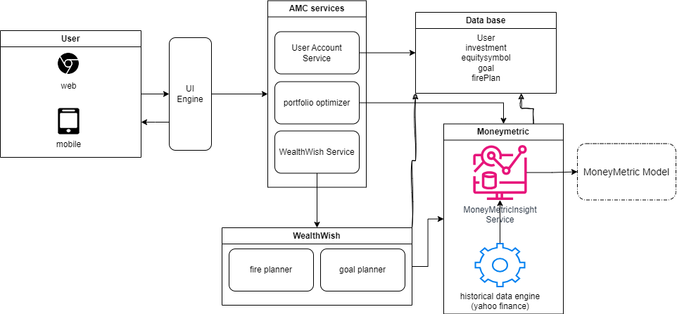
High Level Diagram

Slide 4
Admin Dashboard

Slide 5
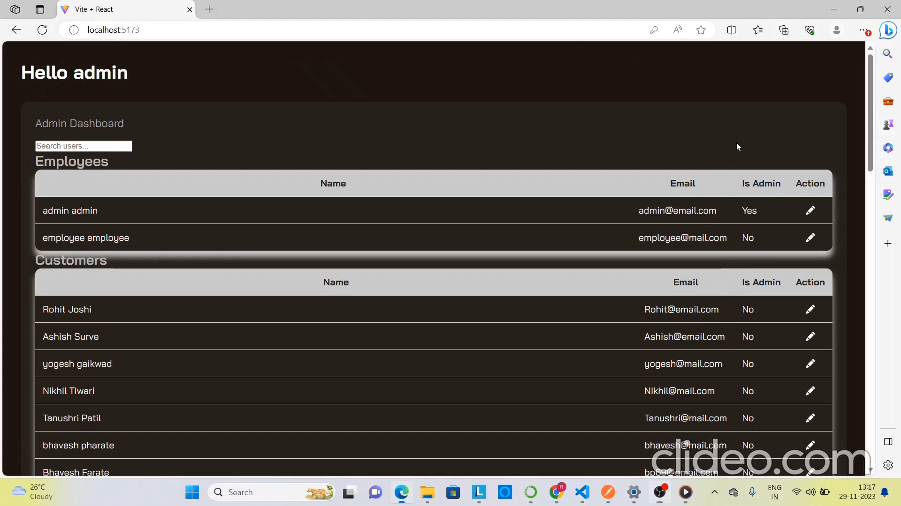

Slide 6
Employee Dashboard

Slide 7
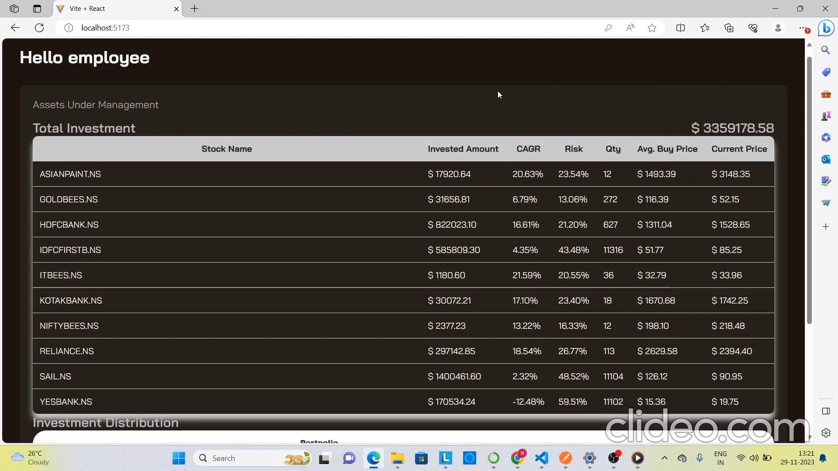

Slide 8
User Dashboard

Slide 9
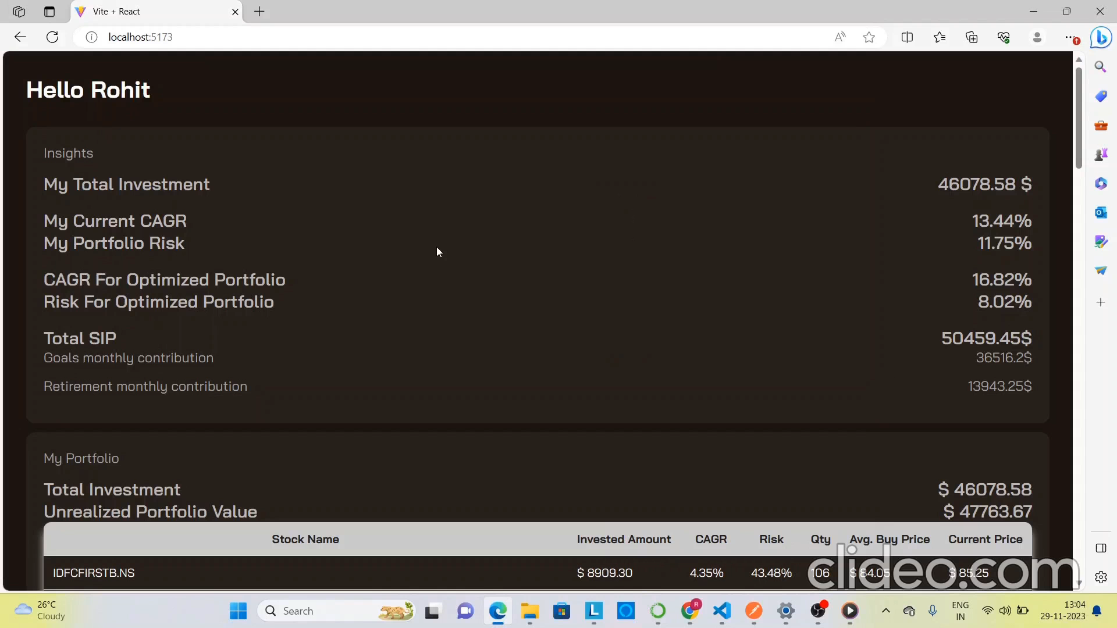

Slide 10
Final User Walkthrough

Slide 11


